Slide 1

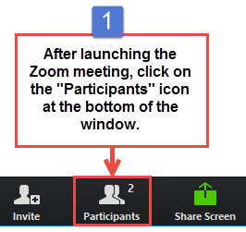
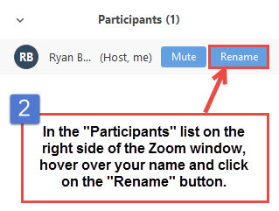
Welcome!
Get pumped and enjoy the music as we give folks a few extra minutes to join!
Update your preferred name (first and last) under “Participants” - option to add pronouns (she/her, he/him, they/them).
Open the “Chat” and type your favorite pump up song!
Notes:
Instructor makes TAs Co-Hosts.
Instructor begins recording the meeting to local computer.
Instructor screen shares this slide while playing upbeat music in background until song ends.
TA(s) admit students from the Waiting Room and reply to students in the Chat.

Slide 2
Generation USA
Orientation Day 1
UDC_JWD Cohort 3
Notes:
Instructor kicks it off!

Slide 3
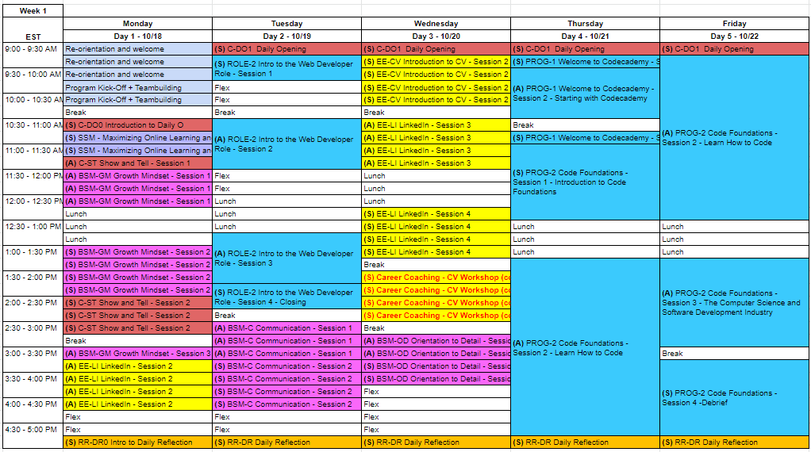

Slide 4
Sdlc phases.
Phase 1: Requirement collection and analysis
Phase 2: Feasibility study:
Phase 3: Design:
Phase 4: Coding:
Phase 5: Testing:
Phase 6: Installation/Deployment:
Phase 7: Maintenance:

Slide 5
SDCL Design phases:
Phase 1: Requirement collection and analysis:
Requirement gathering is the first stage in the SDLC process. It is conducted by senior team members with inputs from all the stakeholders including industry experts.
Project scope is determined at this level, risks anticipated issues, opportunities, and directives on project execution is outlined.
Phase 2: Feasibility study:
Once the requirement analysis phase is completed the next sdlc step is to define and document software needs. This process conducted with the help of 'Software Requirement Specification' document also known as 'SRS' document. It includes everything that will be required to start the design and development process.

Slide 6
Feasibility studies:
Economic: Budget allocation is determined?
Legal: Compliance related maters, cyber law and regulatory framework
Operation feasibility: Can our current operational standard be kept or need some boosting, hiring new team members etc?
Technical: Need to check whether the current computer system can support the software
Schedule: Project execution and completion timeline.

Slide 7

SDLC PHASES.
Phase 3: Design:
The system and software design documents are prepared as per the requirement specification document.
This helps define overall system architecture.
This design phase serves as input for the next phase of the model.
There are two kinds of design documents developed in this phase:
High-Level Design (HLD)
Brief description and name of each module
An outline of the functionality of modules
Interface relationship and dependencies between modules
Database tables identified along with their key elements
Complete architecture diagrams along with technology details

Slide 8
SDLC PHASES:
Low-Level Design(LLD)
Functional logic of the modules
Database tables, which include type and size
Complete detail of the interface
Addresses all types of dependency issues
Listing of error messages
Complete input and outputs for every module

Slide 9

SDLC PHASES:
Phase 4: Coding:
Once the system design phase is over, the next phase is coding. In this phase, developers start build the entire system by writing code using the selected programming language.
In the coding phase, tasks are divided into units or modules and assigned to the various developers. It is the longest phase of the Software Development Life Cycle process.
Developer needs to follow certain predefined coding guidelines.
Developer to use tools like compiler, interpreters, debugger to generate and implement the code.

Slide 10
SDLC PHASES:
Phase 5: Testing:
While the software is been worked on testing will commence in some cases
The testing team starts testing the functionality of the entire system to verify, validate and certify it meets specs are per requirement
QA and testing team may find bugs/defects which they communicate to developers.
The development team fixes the bug and send back to QA for a re-test known as regression test.
This process continues until the software is bug-free, stable, and working according to the business needs of that system.

Slide 11
SDLC Phases:
Phase 6: Installation/Deployment:
Once the software testing phase is over and no bugs or errors left in the system then the final deployment process starts. Based on the feedback given by the project manager, the final software is released and checked for deployment issues if any.
Phase 7: Maintenance:
Once the system is deployed, and customers start using the developed system the following activities continues:
Bug fixing - bugs are reported because of some scenarios which are not tested at all
Upgrade - Upgrading the application to the newer versions of the Software
Enhancement - Adding some new features into the existing software

Slide 12

Systems Design & Analysis

Slide 13

Who is who in this process?
Business users
Business analyst/ system analyst
Program developers
Quality assurance team

Slide 14

System analysis & design
Systems development is systematic process that includes phases such as planning, analysis, design, deployment, and maintenance.
Two Types of Systems we will focus on:
• Systems analysis
• Systems design

Slide 15

Systems Analysis:
Systems Analysis: This is a process of collecting, interpreting, identifying facts vs problems, and decomposing them into components used to either change an existing system or developing a new system. At this stage we concentrate on what the system should do

Slide 16
Type of a Systems:
Systems Design: This is a process of planning a new business system or replacing an existing system by defining its components or modules to satisfy specific requirements. Before planning, you need to understand the old system thoroughly and determine all the relevant issues and how the new product can alleviate and bring about efficiency

Slide 17
System component:
System Analysis and Design (SAD) mainly focuses on the following areas:
Systems
Processes
Technology

Slide 18
Definition of a System
The word System is derived from Greek word Systema, which means an organized relationship between any set of components to achieve some common cause or objective.
A system is “an orderly grouping of interdependent components linked together based on a plan to achieve a specific goal.”

Slide 19
Property of a System:
Organization: This implies structure and order. It is the arrangement of components that helps to achieve predetermined objectives.
Interaction: It is defined by the way the components operate with each other. For example, in an organization, purchasing department must interact with production department and payroll with personnel department.

Slide 20
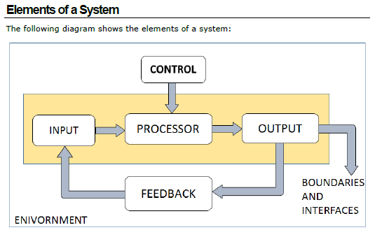
Element of a System

Slide 21
Property of a System
Interdependence: This means how the components of a system depend on one another. For proper functioning, the components are coordinated and linked together according to a specified plan. The output of one subsystem is the required by other subsystem as input.
Integration: This is concerned with how a system component are connected. It means that the parts of the system work together within the system even if each part performs a unique function.

Slide 22
PROJECT SPONSOR
Project Sponsors play a critical role in all projects. Project sponsors have the bandwidth to take on the Project Sponsor role, their day job and no other project role, therefore Project Sponsors are not Project Managers, Scrum Masters or Product Owners.
The Project Sponsor is the person or group that provides direction and resources, including financial resources for the software project. The Project Sponsor works with the project management team, aiding with wider project matters such as scope clarification, progress, monitoring, and influencing others in order to benefit the software project.
The Project Sponsor leads the project through the software supplier selection process until it is formally authorised. For issues that are beyond the control of the Product Owner, the Project Sponsor serves as an escalation path.
The Project Sponsor may also be involved in other important issues such as authorising changes in scope, phase-end reviews, and go/no-go decisions when the stakes of the project are particularly high.
Typically sponsors of projects tend to be senior management or director level executives.

Slide 23

Business Analyst
Business Analyst is the person that does research, plan, coordinate and recommend software solution to an organization
Quality of a BA
Analytical
Technical
Managerial
Interpersonal skills

Slide 24
Role of a SOFTWARE DEVELOPER:
The Software Developers (front-end and back-end) are responsible for using the technical requirements from the Technical Lead to create cost and timeline estimates.
The Software Developers are also responsible for building the deliverables and communicating the status of the software project to the Technical Lead or Project Manager.
It is critical that the other team members effectively communicate the technical requirements to the Software Developers to reduce project risk and provide the software project with the greatest chance of success.

Slide 25
Role of a BA in the SDLC process
Brings together stakeholders to help determine scope, objective of the program and establish channel of communication
Knowledgeable of the business and has the ability to understand and clearly communicate expectations
Must be analytical and able to assess and validate business users needs and maintain a flow within a given budget
Must be good in handling changes and relay them accurately

Slide 26
Role of QA Tester:
Obtains requirement, function design, internal design, specifications and users stories. Etc
Identify application’s high-risk area for priority testing
Determine test environment and test wear and test inputs
Identify task and allocate labor based on skill set
Prepare test plans and test cases and recommend UAT
Execute test, verify and validate program before UAT

Slide 27
SDLC common issues
Poor requirement
Unrealistic expectorations
Inadequate Testing
Lack of coordination
Futuristic , controlling add ons, and changes

